Slide 1
INJURY PREVENTION FOR SPORTS PLAYERS MuscleGuard Analytics
-Deepesh Kumar A.S. 21011102027
-Harshath.U-21011102037
-Krithiga .R-21011102051

Slide 2
Problem Statement :
To help lot of aspiring athletes from injury by an IOT device and prevent few muscle injuries and help them to reach their goal in their respective sports. This also improves their sports performance and detailed plan to prevent them from injury and strengthening them.

Slide 3
Solution:
Injury Prevention: IoT device and system that can effectively monitor an athlete's physical condition and provide timely warnings and recommendations to reduce the risk of muscle injuries and other common sports-related injuries.
Performance Enhancement: Implement features that not only prevent injuries but also enhance an athlete's performance by optimizing their training regimen and helping them reach their peak potential.
Personalization: Develop a solution that tailors injury prevention and performance enhancement strategies to each athlete's unique needs and characteristics, considering factors like sport, age, gender, fitness level, and injury history.

Slide 4
Innovation
Real-time Monitoring: Create wearable EMG sensors that provide real-time feedback to athletes and their coaches. These sensors should be lightweight, comfortable, and capable of transmitting data wirelessly to a central monitoring system.
Biomechanical Analysis: Combine EMG data with other biomechanical measurements (e.g., joint angles, force, acceleration) to gain a more comprehensive understanding of an athlete's movements and muscle activity, which can aid in injury prediction.
Predictive Analytics: Implement predictive analytics that can forecast injury risk based on historical data, training load, and an athlete's physical condition. This allows athletes and coaches to adjust training plans proactively.

Slide 5
Business Model
Enterprise Solutions:
Provide enterprise-level solutions to sports teams, universities, and training facilities.
Customized packages for organizations with multiple athletes or teams, including coaching support, analytics, and comprehensive athlete management.
Hardware Sales:
Sell the EMG sensors as standalone devices to individual athletes and coaches.
Offer bulk purchase options for sports organizations and facilities

Slide 6
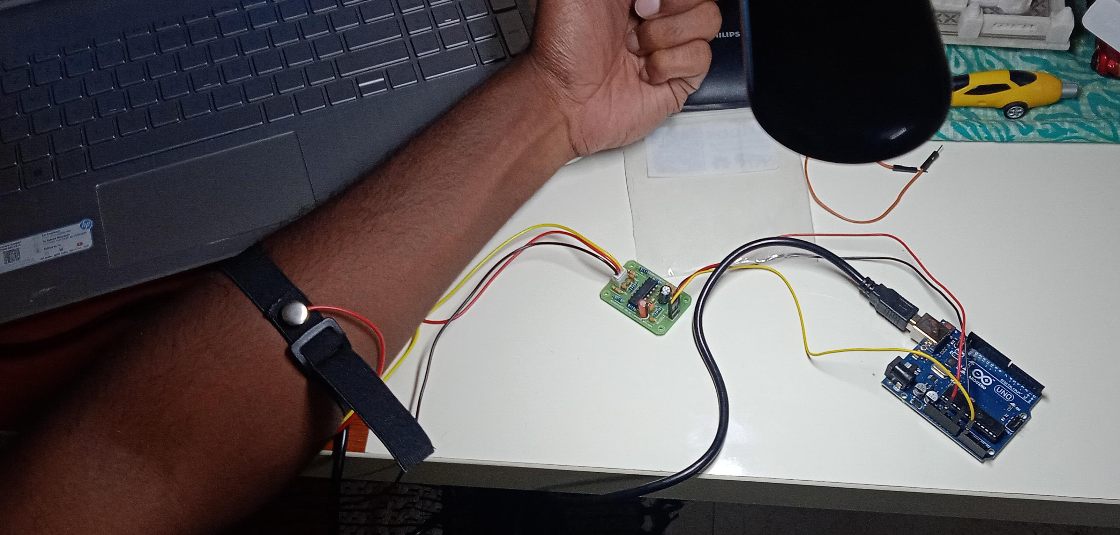
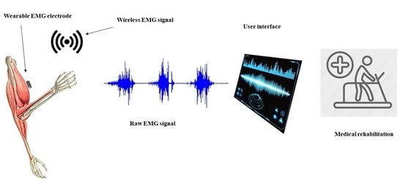
Hardware :
EMG BIOAMP SENSORS
Arduino Uno
Electrodes

Slide 7
Software
Usage of Arduino Sketch
Matlab to emg signal processing
Excel Dashboards
Performance Evaluation Report
https://deepesh21110211.wixsite.com/muscleguard-analytic

Slide 8
Future Plan :
To develop Multiple EMG sensors to perform Predictive Analysis for multiple muscles.

